Slide 1
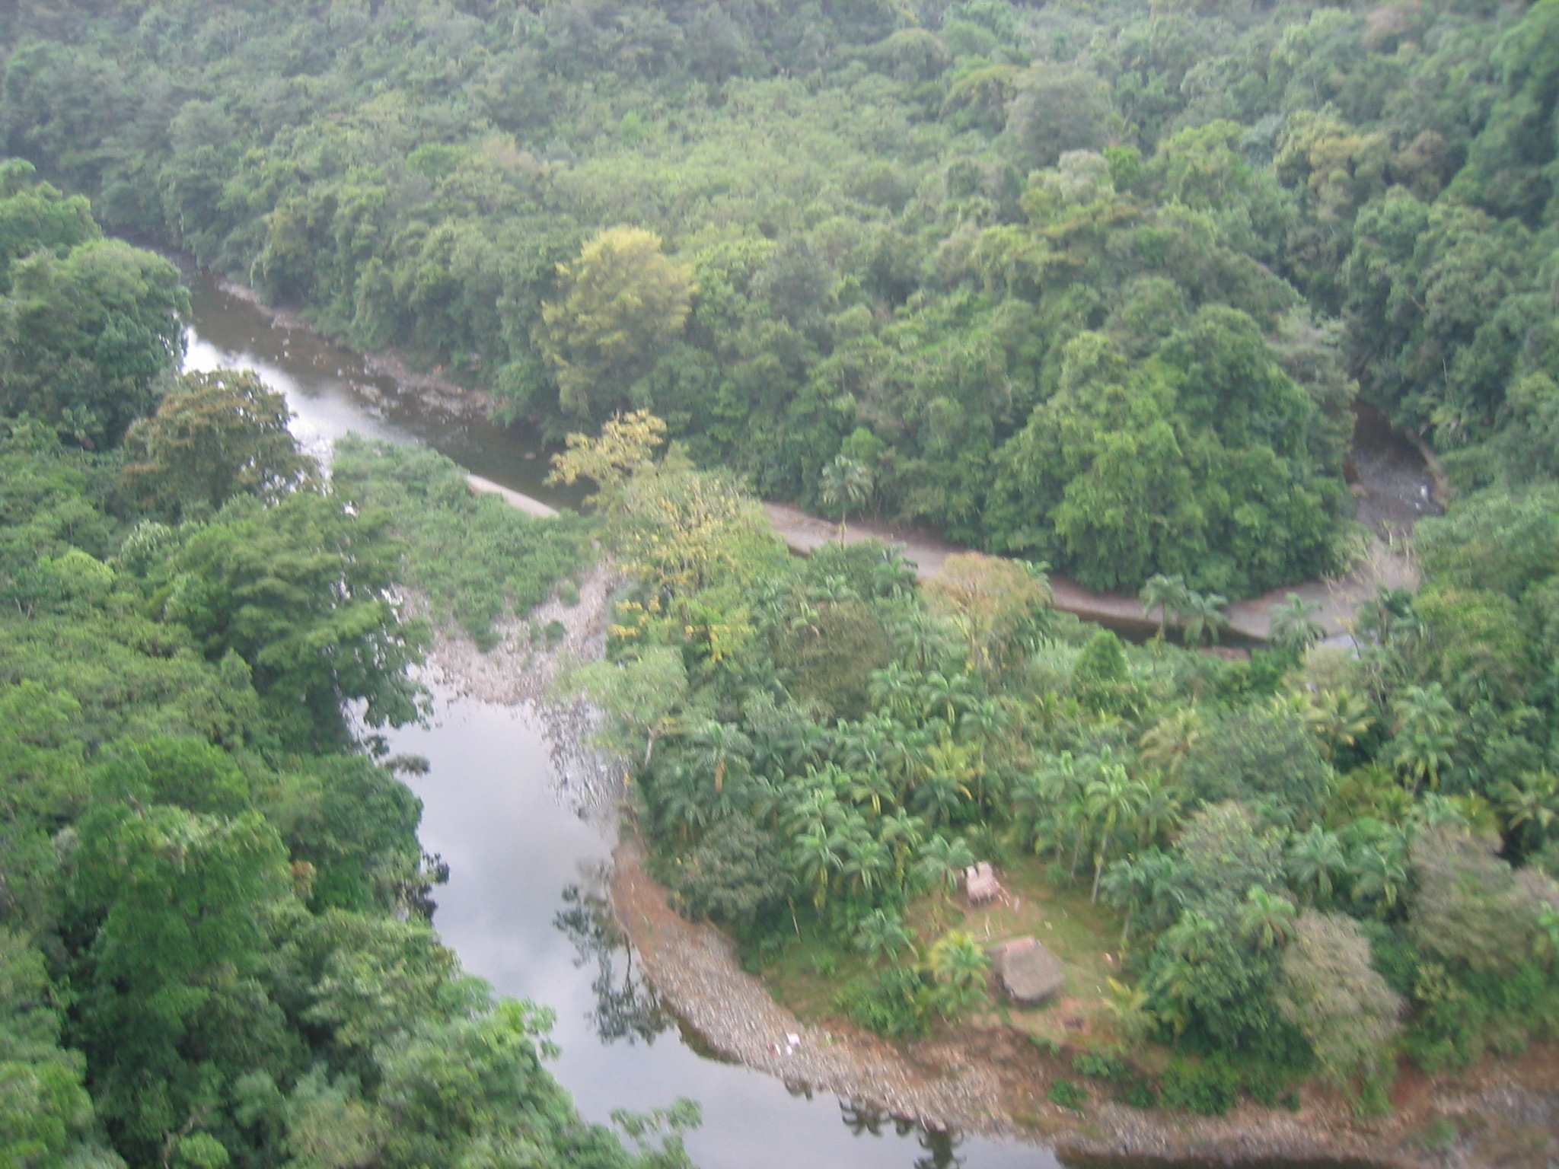
Determining long term erosion rates in Panama
An application of ¹⁰Be
Veronica Sosa-Gonzalez

Slide 2
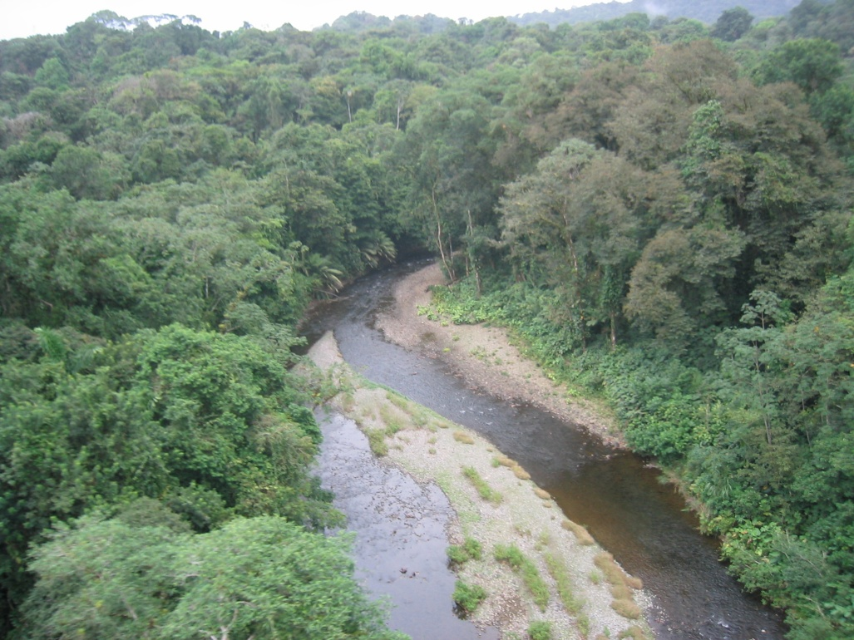
Introduction and Background
Erosion effects on water resources
Human influences on sediment generation
Photo credits: K. Nichols

Slide 3
Introduction and Background
Cosmogenic isotopes
Near-surface residence time
Provide long-term data
Cosmic rays
Quartz
(SiO₂)
²⁶Al, ³He, ²¹Ne
³He, ¹⁰Be, ¹⁴C

Slide 4
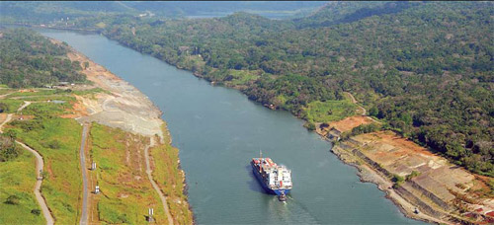
Introduction and Background
Avoid sediment increase in Panama
Use of cosmogenic nuclides, as a proxy for erosion, in tropical climates
Photo credits: US Agency of International Development

Slide 5
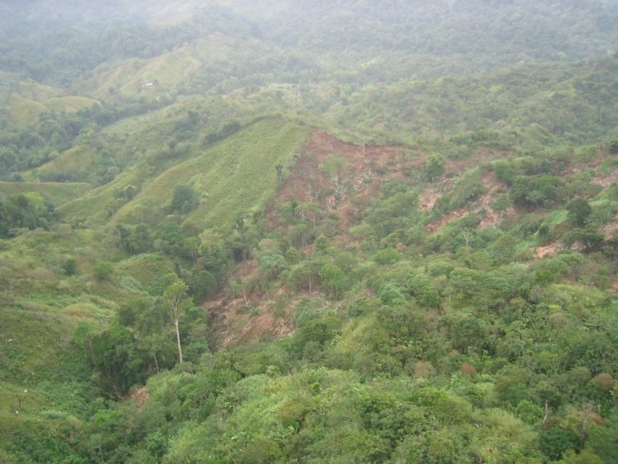
Objectives
Determine long-term background erosion rates in Panama using ¹⁰Be
Explore the physiographic controls on erosion in tropical climates
Quantify the sediment input on rivers as an effect of landslides
Photo credits: K. Nichols

Slide 6
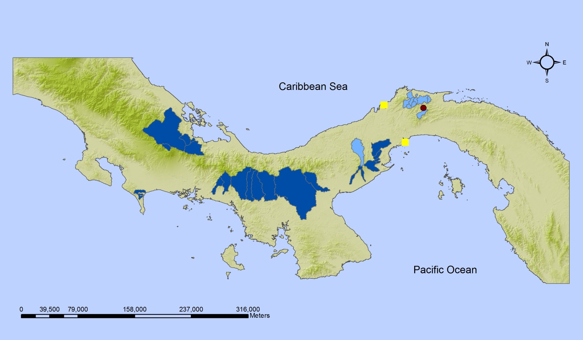
Methods
Sampling
2002- Rio Chagres
2004- comparison to Rio Chagres
2007- spatial variation of erosion rates
Notes:
- Northern watersheds, 2004: comparison with previously obtained erosion rates
- Southern watersheds, 2007: determine spatial variance of erosion at the country scale

Slide 7
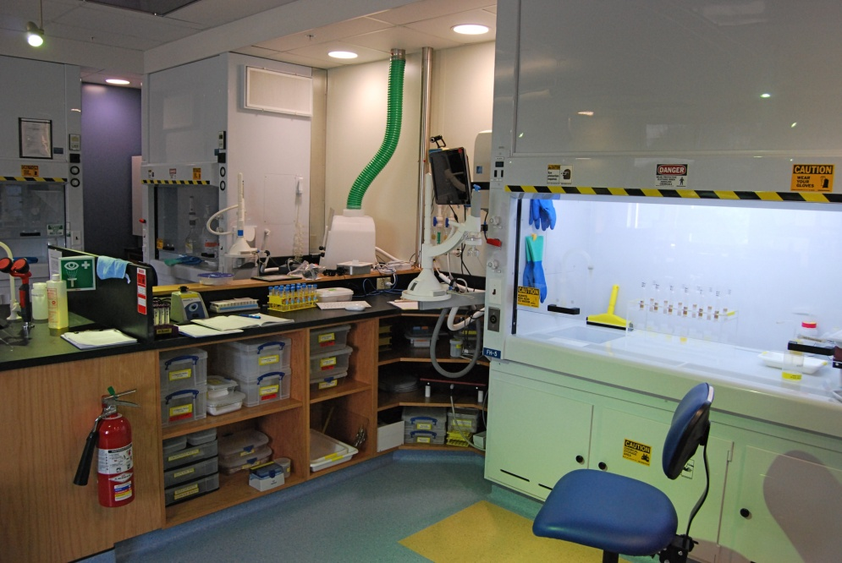
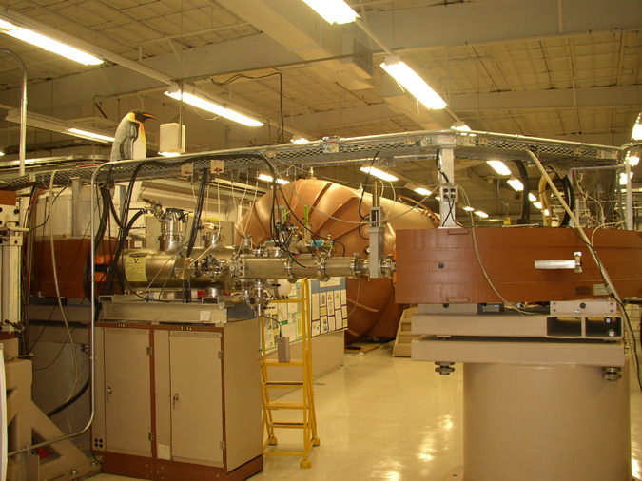
¹⁰Be extraction and analysis
UVM Cosmolab
LLNL Center for Accelerator Mass Spectrometry
CRONUS Earth
Analysis
Spatial
Statistical
Photo credits: P. Bierman
Photo credits: L. Reusser

Slide 8
Preliminary Results

Slide 9
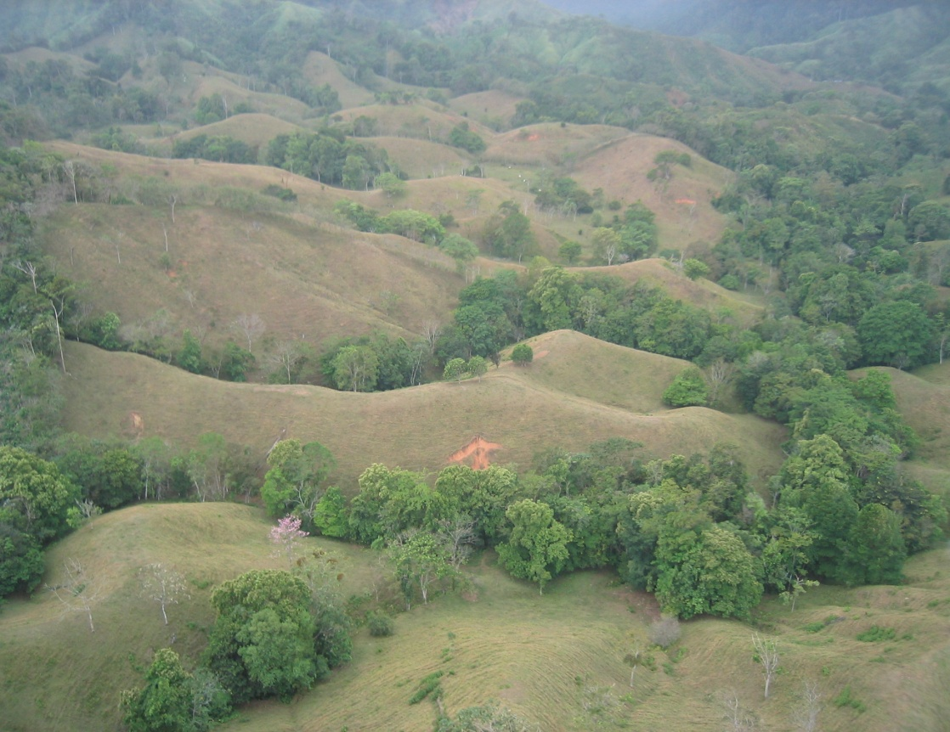
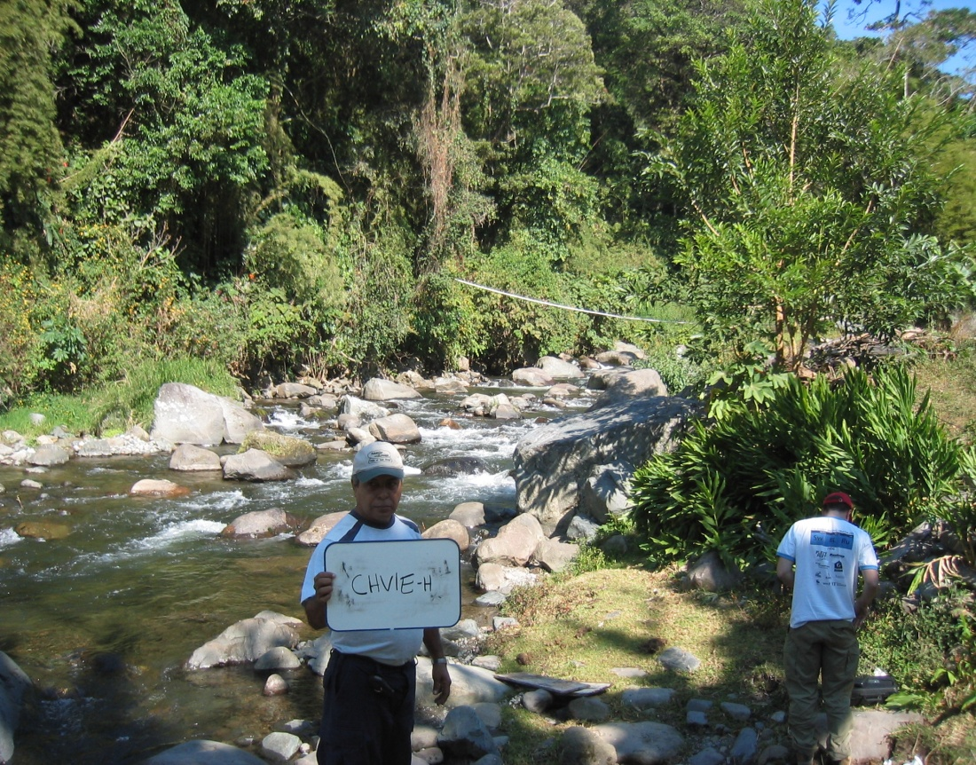
Thanks for your attention

